Slide 1
Ergonomics and Biomechanics
Prepared by:
Sherwin Andrew M. Lucero
IV - BS Physical Therapy
UP Manila - College of Allied Medical Professions
For PT 138 Teaching in Physical Therapy Fieldwork

Slide 2
Learning Objectives
Discuss the general concepts and principles of ergonomics and biomechanics
Describe the different musculoskeletal conditions that can develop from improper biomechanics
Determine the biomechanic and ergonomic principles applied in a given scenario

Slide 3
Ergonomics
Ergon (work) + nomos (law) = ¨the science of work¨
Study of work performance with an emphasis on worker safety and productivity. (Bettencourt and Jacobs, 1995)

Slide 4
Ergonomics
Application of scientific knowledge to the workplace in order to improve the well-being and efficiency of both the individual and the organization. (National Research Council of Canada)

Slide 5
Ergonomics
Human factors (ergonomics) is a body of knowledge about human abilities, human limitations and other human characteristics that are relevant to design.¨ (Chapanis, 1991 as cited by Bettencourt and Jacobs, 1995)

Slide 6
Biomechanics
Study of human movement using mechanical principles
Uses laws of physics and engineering concepts to describe motion undergone by the various body segments and the forces acting on these body parts during normal daily activities. (Frankel and Nordin, 1980 as cited by Andersson, et. al, 1999)

Slide 7
Occupational Biomechanics
Study of the physical interaction of workers with their tools, machines and materials so as to enhance the worker's performance while minimizing the risk of musculoskeletal disorders. (Andersson, et. al., 1999)

Slide 8



Slide 9



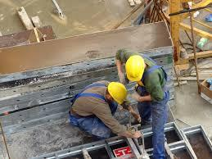
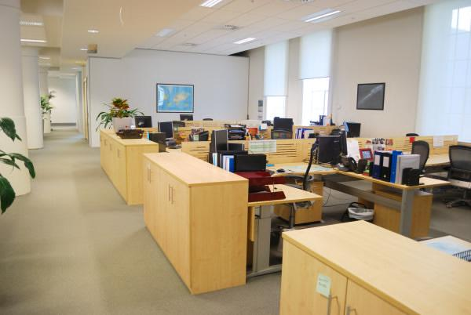

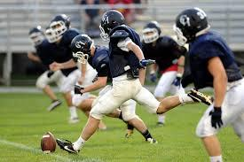
Examples of Workplace Areas or Fields
School
Home
Hospital/clinic
Office
Construction site
Sports
Farm/Gardening

Slide 10
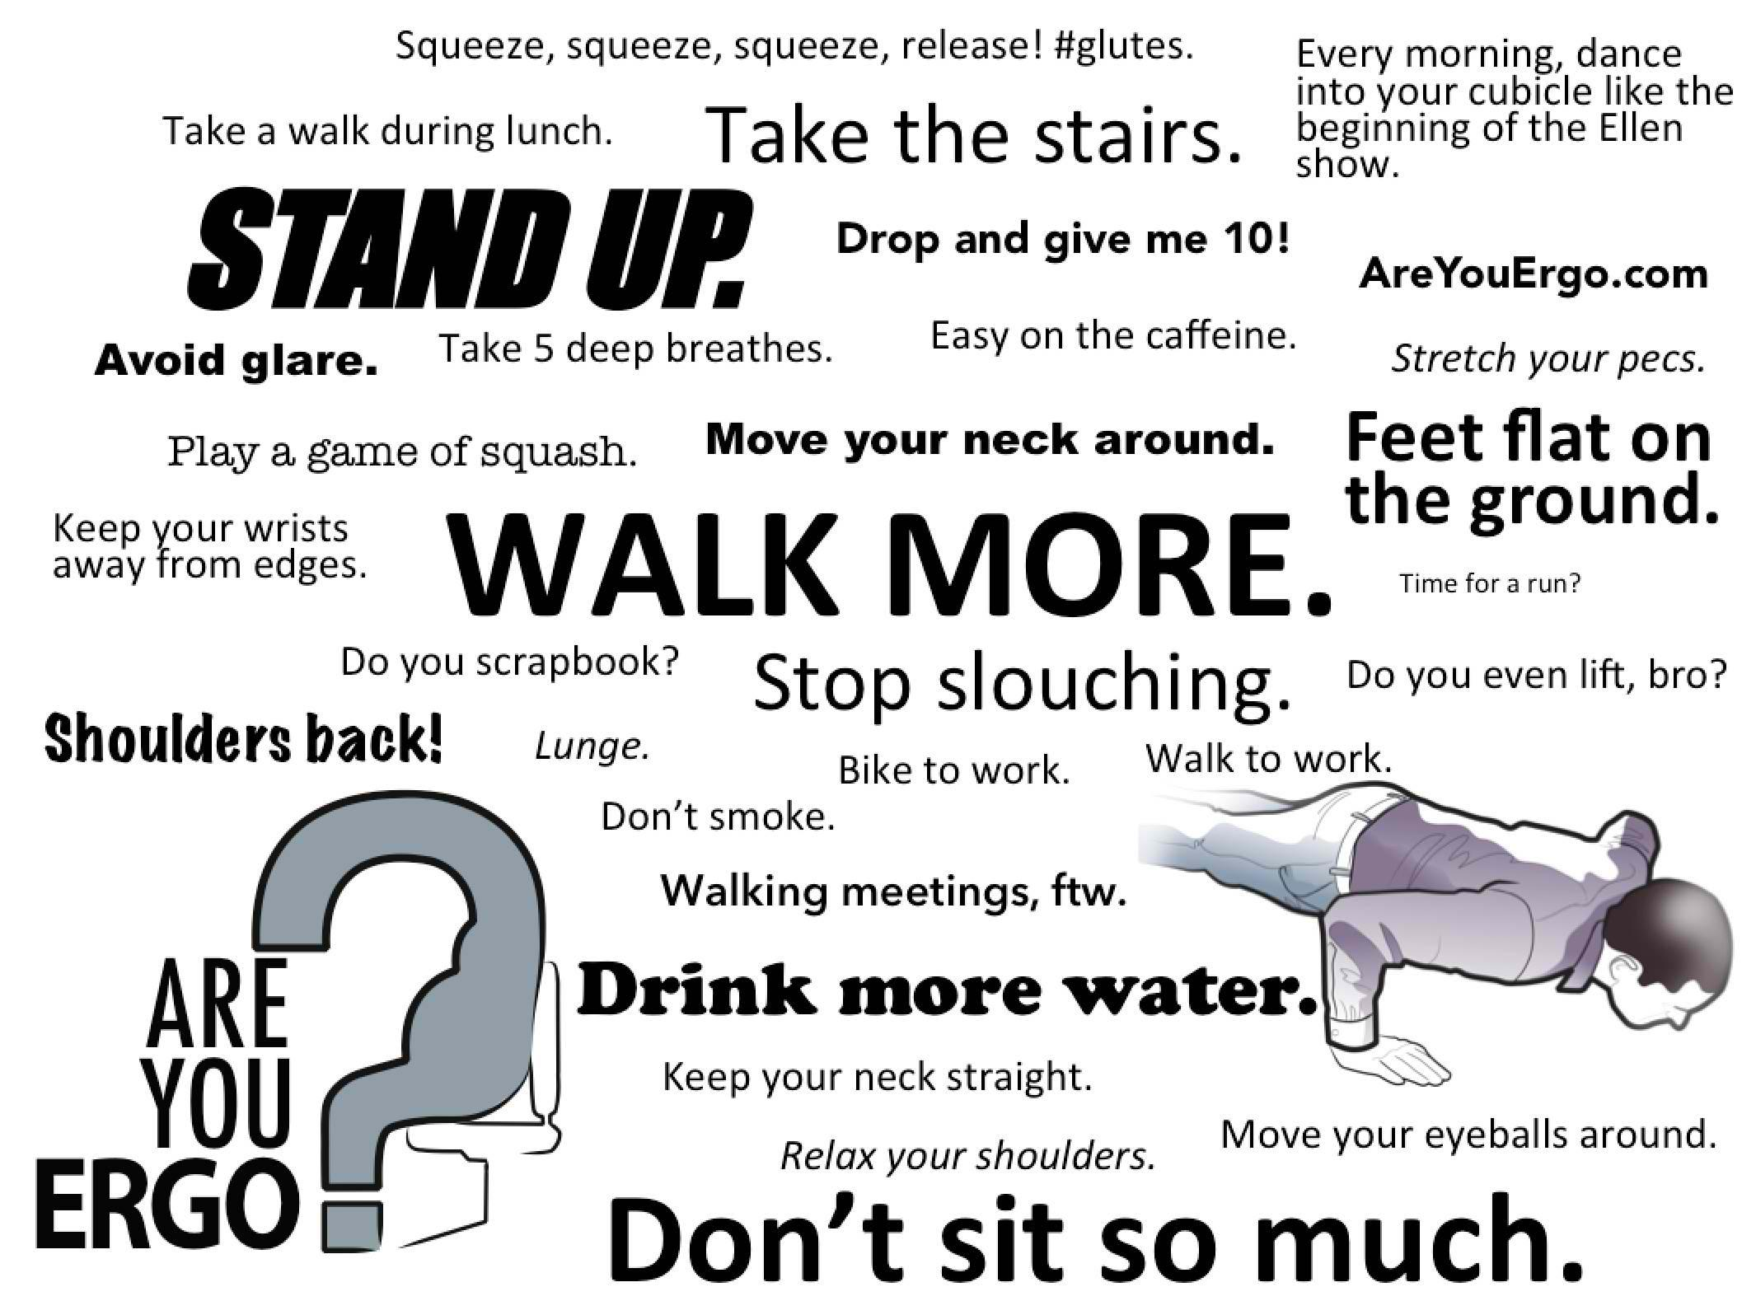
Ergonomics and biomechanics are everywhere!

Slide 11
Ergonomic and Biomechanic Principles and Guidelines

Slide 12


Ergonomic and Biomechanic Principles and Guidelines
Computer workstation
Lifting

Slide 13
Computer Workstation

Slide 14
Computer Workstation
Monitor
Place monitor directly in front of you with head straight and eyes looking forward.
Top of monitor screen should be at eye level or slightly below eye level (15º below eye level).
Set monitor 18¨-30¨ from the eyes or use the arm length rule (monitor approximately an arm length away from you).

Slide 15
Computer Workstation
Ensure font size is large enough and adjust monitor brightness and contrast.
Eliminate monitor screen glare by reducing room lighting, covering windows with curtains, blinds or tints or tilting the monitor to avoid overhead lighting.

Slide 16
Computer Workstation
Keyboard
Think 90º! (position keyboard with wrists straight and elbow at 90º or slightly more than 90º). Adjust chair height or keyboard tray if necessary.
Consider using a separate keyboard on an adjustable keyboard tray. If a separate keyboard tray is not available, adjust chair height and place feet on a small footrest/stool to maintain right angles.

Slide 17
Computer Workstation
Wrist and palm rest/support may be helpful during breaks. However, DO NOT use it when actively typing as it may bend the wrist and put excessive body weight through it.

Slide 18
Computer Workstation
Mouse
Position the mouse next to and at the same height as the keyboard.
Initiate movement FROM THE SHOULDER rather than from the wrist.
Use a separate mouse rather than a trackball or other cursor-moving device.
It's all in the keys! When possible, use keyboard shortcuts to minimize wrist strains.

Slide 19
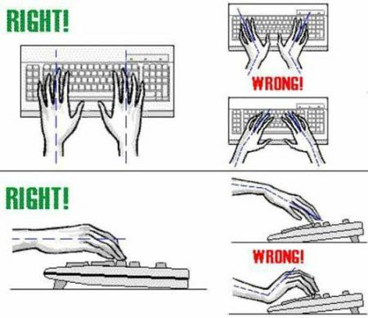

Slide 20
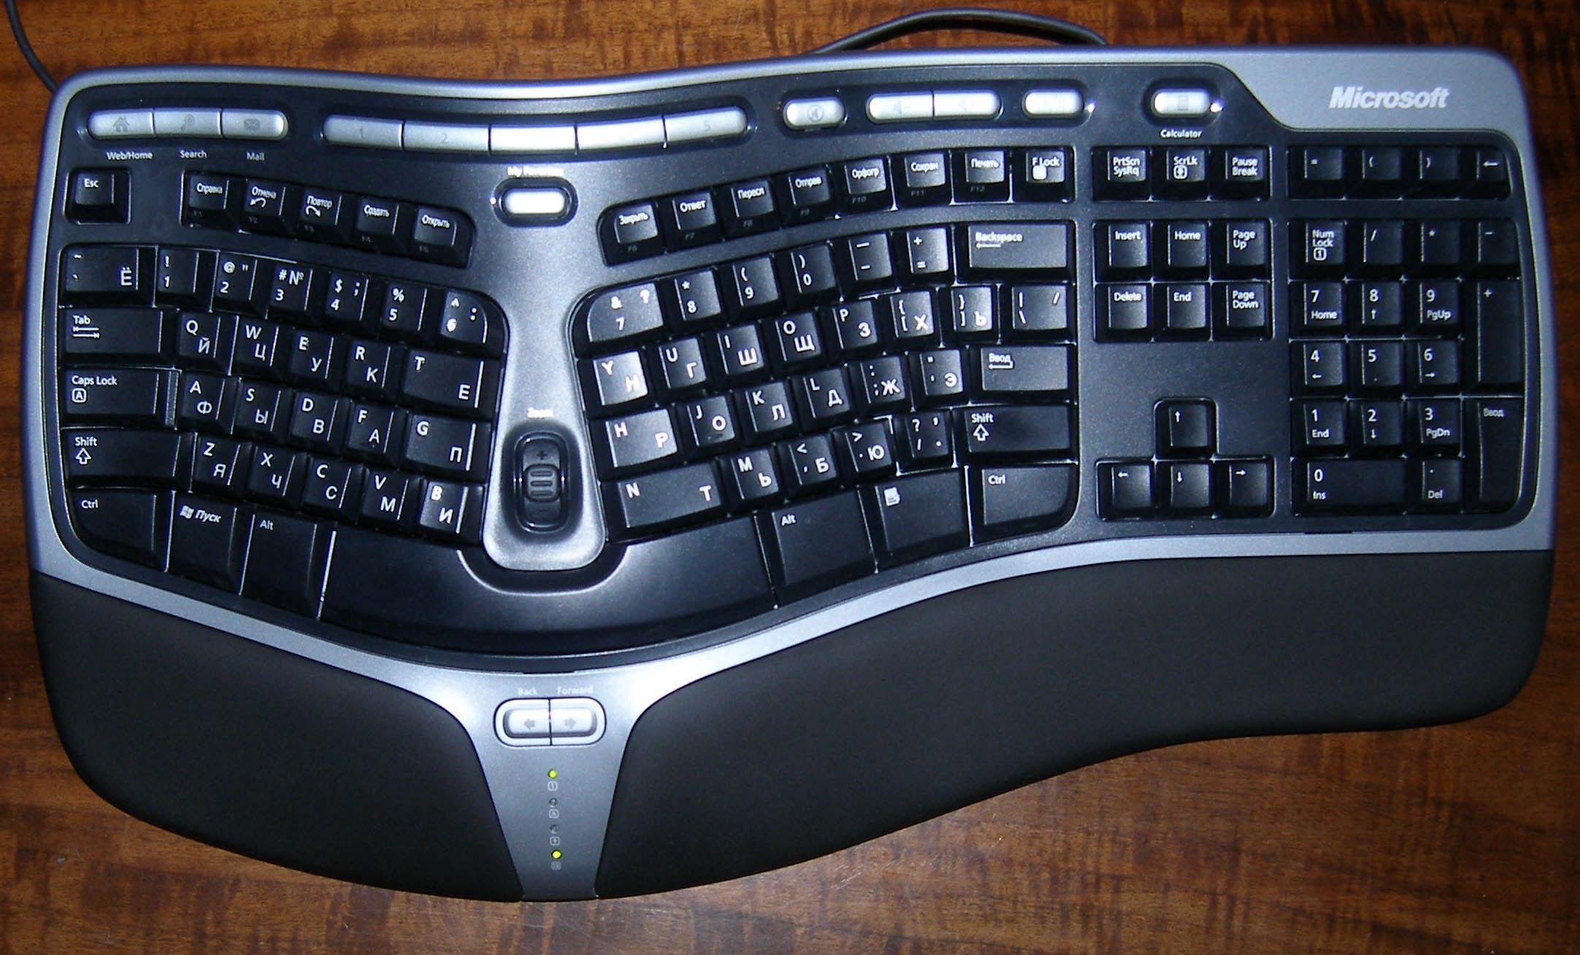
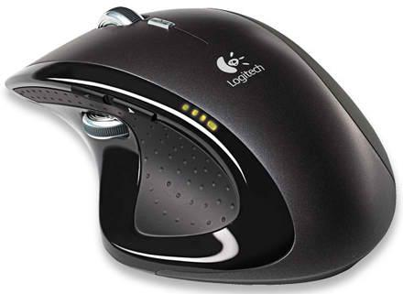
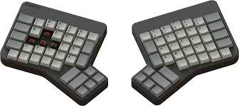
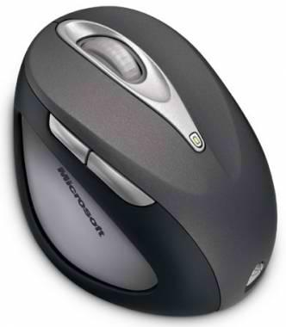

Slide 21
Computer Workstation
Desk
Space under desk should be at least 30¨ wide, 19¨ deep and 27¨ in height.
There should be 2¨-3¨ distance between top of thighs and desk.
At least 30¨ of desk depth is recommended.

Slide 22
Computer Workstation
Chair
Think 90º! (adjust height of chair with hips and knees in 90º or slightly more than 90º). Keep feet flat on the floor or use a footrest if necessary.
Tip: When adjusting, stand in front of chair so that highest point of seat is just below the kneecap.

Slide 23
Computer Workstation
Seat should be as wide as the user's thighs (typically 17¨-20¨ for most office workers).
Seat depth must be 2-3 fingers away from the front edge of the seat and back of the knee.

Slide 24
Computer Workstation
Use a chair with a cushioned lumbar support. If lumbar support is not available, a towel roll can be placed at the lower back just above the waistline.
Tip: Use chair with upper back and/or neck support to minimize back and neck pain.
Chairs with arm rests, pneumatic seat height adjustment, back height and seat depth adjustment and 360º swivel are recommended.

Slide 25
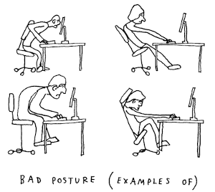

Slide 26
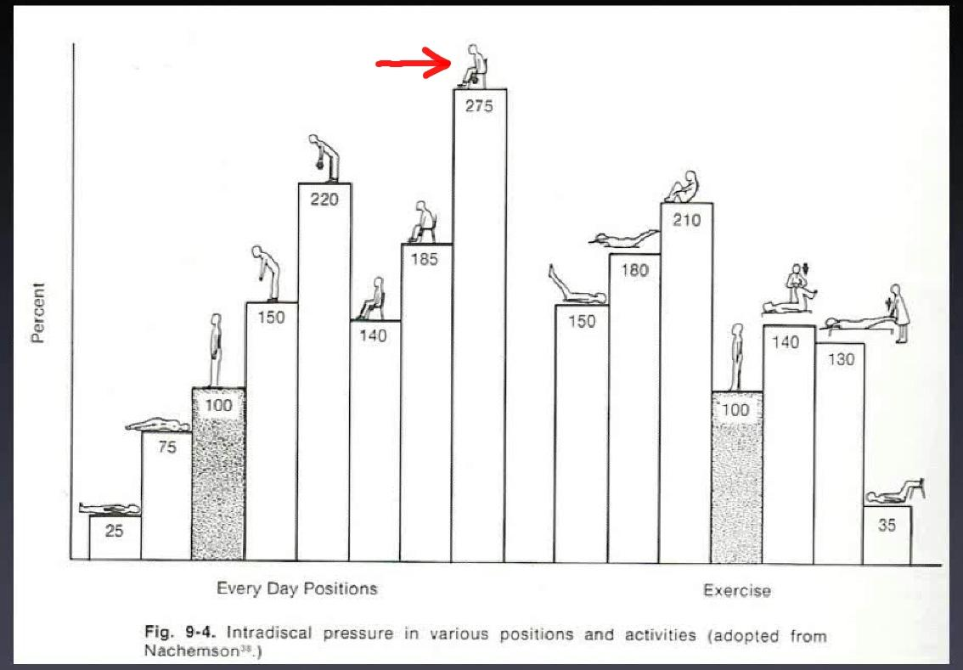

Slide 27
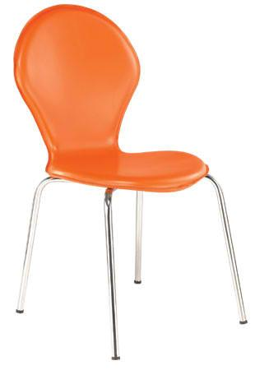
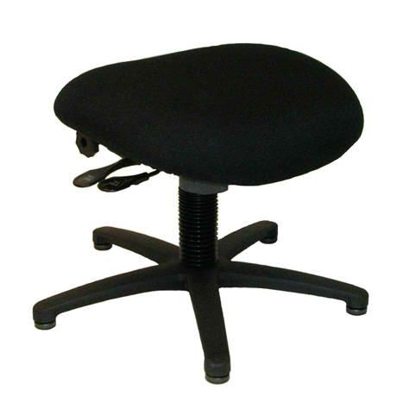
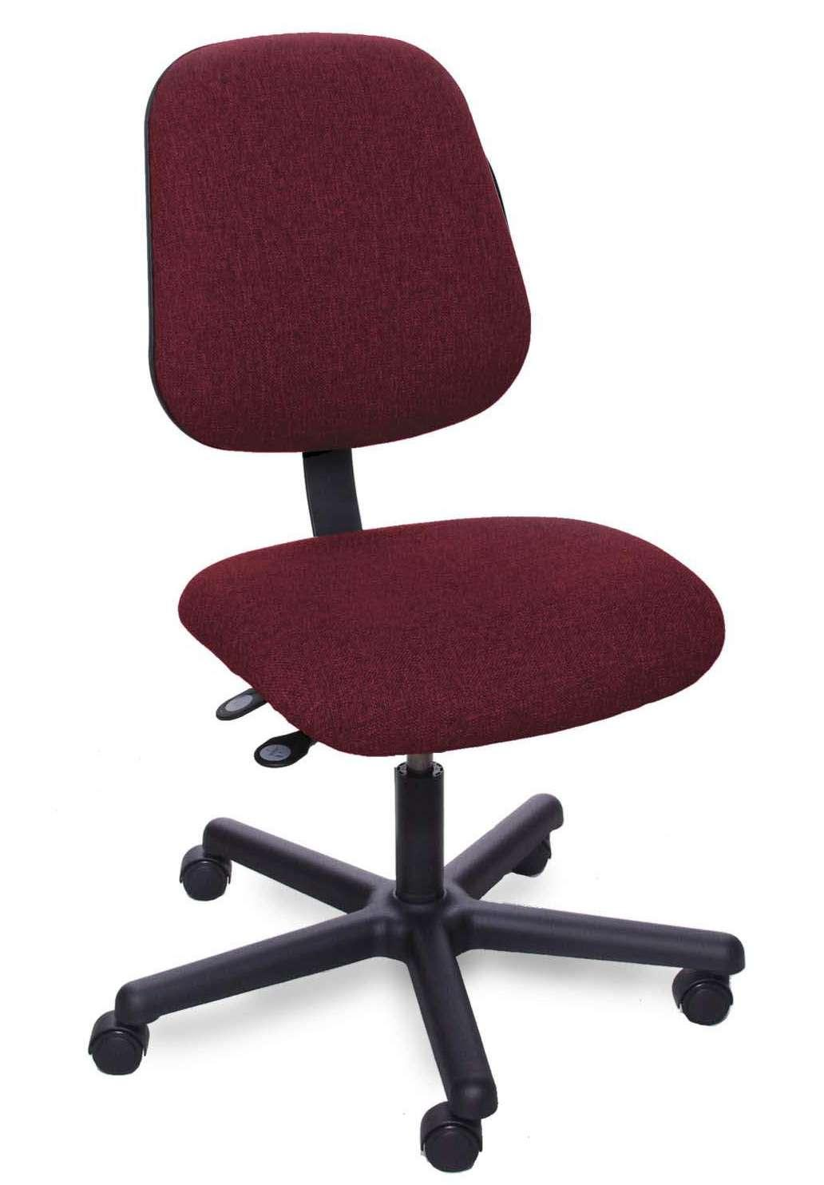
WRONG!

Slide 28
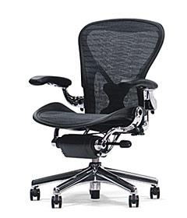
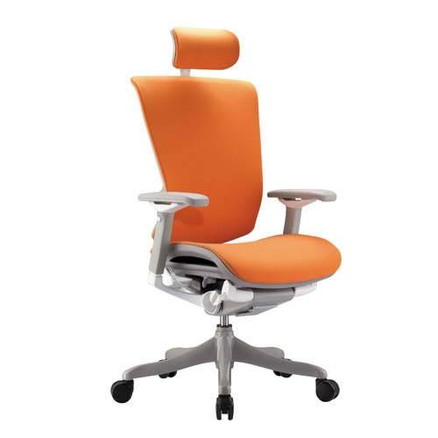
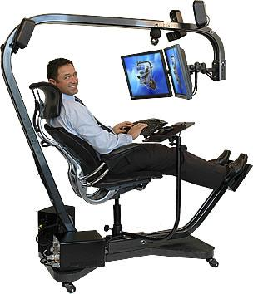
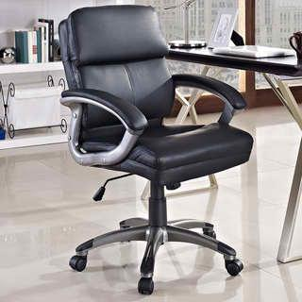
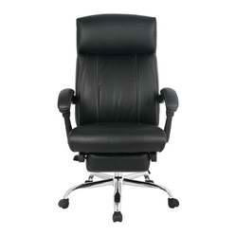

Slide 29
Computer Workstation
Accessories
Document holder: same distance and height as the monitor and same side as the dominant eye.
Desk lamp: used when room lighting is reduced.
Headset and telephone: consider using a headset if frequently using a telephone; if not using a headset, hold receiver with one hand and DO NOT cradle it between your ear and shoulder.

Slide 30
Computer Workstation
YOU
¨Think straight (think 90º).¨
Observe proper posture and body alignment.
Use a footrest.
¨Relax.¨
Distribute weight evenly.
Keep light mouse grip and key stroke.

Slide 31
Computer Workstation
¨So close yet so far.¨
Keep elbows close to the body but still observe proper distance and body alignment.
Keep office equipment such as telephones or binders within your reach but still observe proper posture and body alignment during reaching.

Slide 32
Computer Workstation
¨Have a break, have a chitchat.¨
Stand up, walk a little, drink water, chat with an officemate
Stretch neck, shoulders, forearm, wrist and back
20-20-20 rule: after 20 mins. at the computer, turn away from screen and look at an object 20 ft. away for 20 secs.
Usually taken every after 10-20 mins. for 2-5 mins.

Slide 33
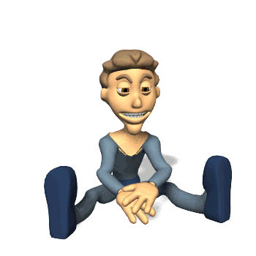
Stretch for a while! :)

Slide 34
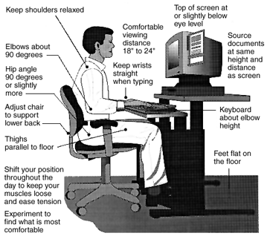

Slide 35
Lifting

Slide 36
Lifting - Principles of Biomechanics
Plan the lift and test the load
Keep the object close to the body
Use larger muscles to perform heavy work
Maintain wide base of support
Pivot your feet while lifting and avoid bending and twisting the trunk/back

Slide 37
Lifting - Principles of Biomechanics
Maintain a slow and consistent speed and avoid jerking
Attempt to push, pull, slide or roll the object prior to lifting (push or pull in a semi-squat position). Only lift an object as a last resort.
Know your limitations and hesitate to ask for help.

Slide 38
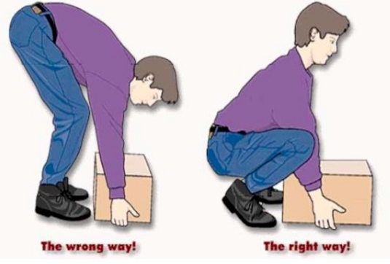

Slide 39
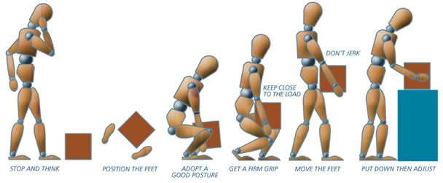

Slide 40
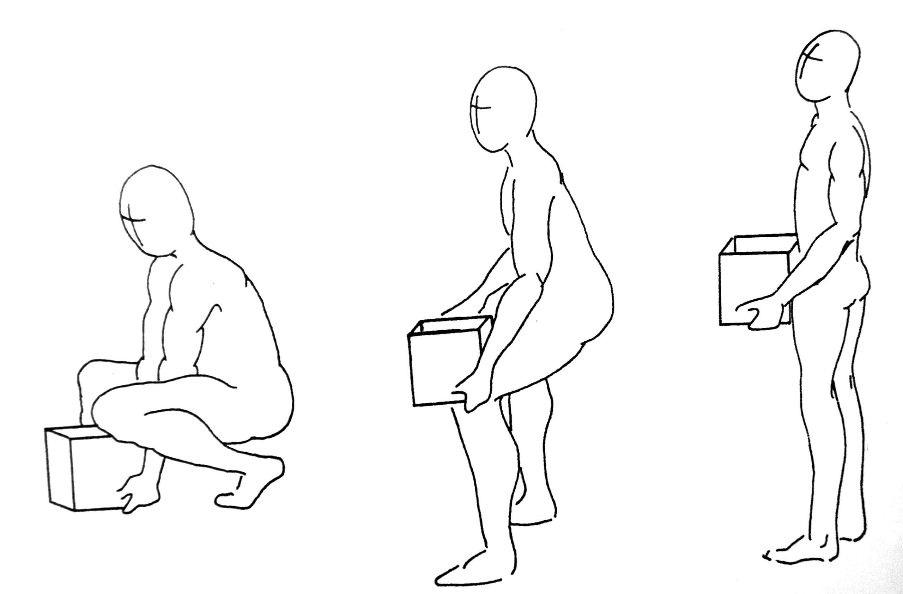
Proper Lifting Techniques
Deep Squat Lift
Hip lower than knee
Straight back
Risk for knee problems

Slide 41
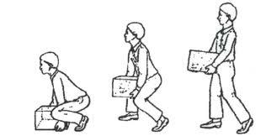
Proper Lifting Techniques
Diagonal Lift
For people with knee problems

Slide 42
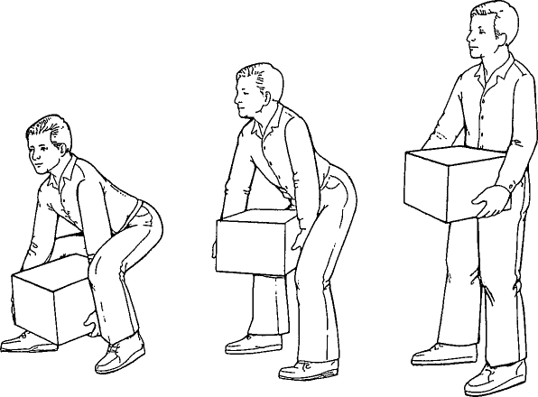
Proper Lifting Techniques
Power Lift
Hips higher with knees bent 90º
Wide base of support

Slide 43
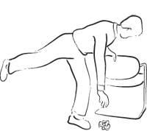
Proper Lifting Techniques
Golfer's Lift
For picking up small objects
Non-lifting arm for counterbalance

Slide 44



Slide 45
Benefits of Proper Observation of Ergonomic and Biomechanic Principles and Guidelines

Slide 46
Benefits
Reduces employee turnover
Returns to work earlier
Increases productivity
Increases product quality
Increases employee morale

Slide 47
Benefits
Facilitates proper breathing
Increases concentration and thinking ability
Improves image
Increases self-confidence/self-esteem
Minimizes unwanted and poor body conditions

Slide 48
General/Common Conditions Acquired from Improper Biomechanics

Slide 49
General/Common Conditions
Eyestrain
Neck pain
Shoulder pain
Elbow/wrist/hand pain
Back pain (upper and lower back)
Thigh/leg pain
Knee pain

Slide 50

Eyestrain
Caused by:
Glare
Too much/too little light
Lack of task variation
Reading material too close/too far
Uncorrected vision

Slide 51
Neck Pain
Caused by:
Monitor too high, too low or too far
Chair too low
Improper monitor and/or document positioning
Poor sitting posture and/or lack of position change

Slide 52
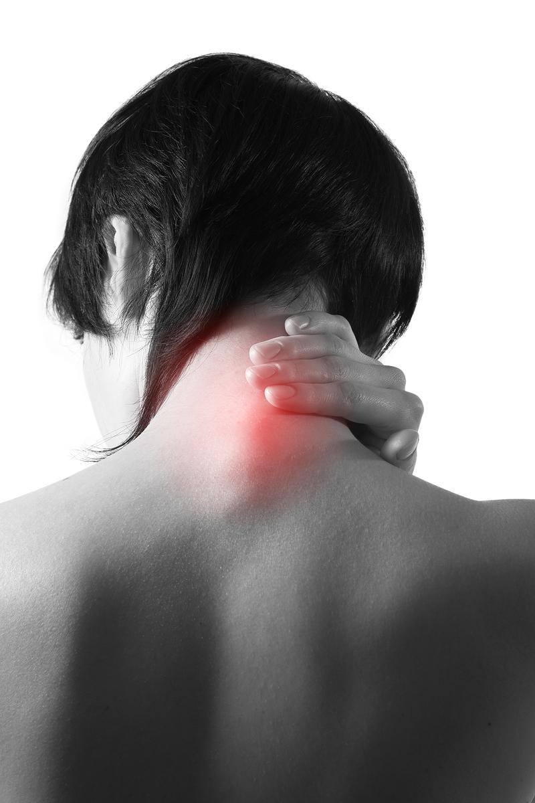
Neck Pain
Keyboard too high
Bi-/tri-focal use

Slide 53

Shoulder Pain
Caused by:
Armrests too high
Desk and/or keyboard too high
Poor posture from prolonged position
Reaching for overhead binders while seated
Extended reaching for frequently used equipment or files

Slide 54

Elbow/Wrist/Hand Pain
Caused by:
Keyboard too high/too low
Keyboard tilt
Deviation of wrist during typing
No wrist support for keyboard and/or mouse

Slide 55
Elbow/Wrist/Hand Pain
Lack of task variety
Hand tenseness (writing/keyboarding/mouse usage)
Resting body part on sharp edge

Slide 56
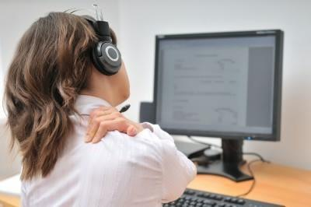
Upper Back Pain
Caused by:
Prolonged sitting
Desk too high/too low
Chair height
Monitor/document too far

Slide 57
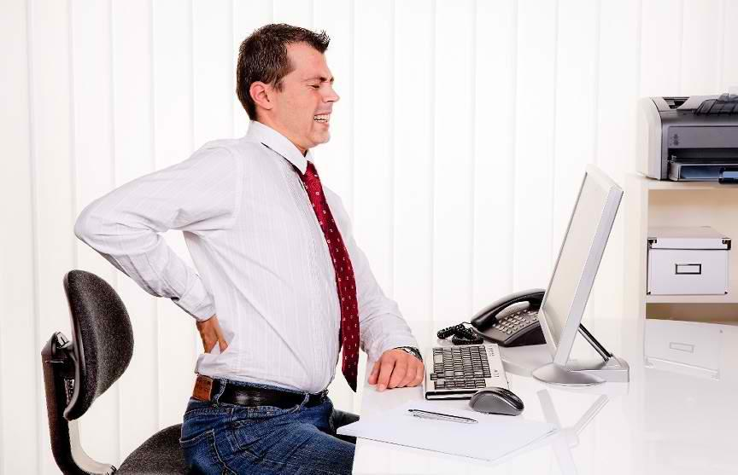
Lower Back Pain
Caused by:
Prolonged sitting
Poor sitting position
Chair too high/too low
Poor chair condition/fit
Bending or twisting while reaching within the workstation or while lifting

Slide 58
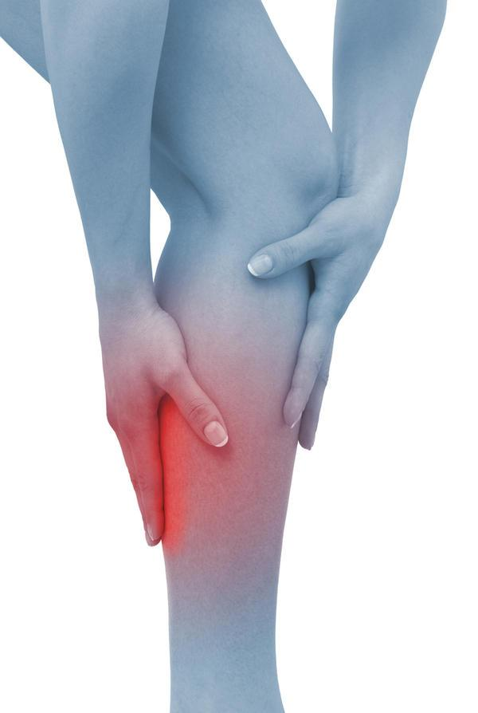
Thigh/Leg Pain
Caused by:
Poor posture
Lack of footrest to support legs
Poor seat depth fit
Lack of seat padding

Slide 59
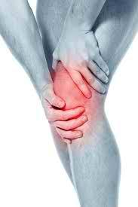
Knee Pain
Caused by:
Poor sitting leg posture
Excessive bending of knees when lifting

Slide 60
Group Activity: Determining Principles of Ergonomics and Biomechanics

Slide 61
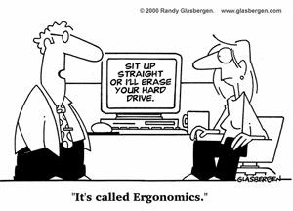

Slide 62
References
Bettencourt, K. and Jacobs, C.M. (1995). Ergonomics For Therapists. Massachusetts: Butterworth-Heinemann.
Andersson, G. B. J., et. al. (1999). Occupational Biomechanics. Canada: John Wiley & Sons, Inc..
Hadler, N. M. (1999). Occupational Musculoskeletal Disorders. Philadelphia: Lippincott Williams & Wilkins.
Cayco, C.S. (2013). Ergonomics and Biomechanics. PT 142: Assessment in Physical Therapy. Lecture Class conducted at UP-CAMP.
http://safety.ttu.edu/2013/11/05/ergonomics-in-the-office/
http://productivewriters.com/2011/09/12/writing-ergonomics-posture-alignment-writer/
http://www.wcb.ab.ca/pdfs/public/office_ergo.pdf
http://hubpages.com/hub/Proper_Posture_for_Computer_Use
http://personalexcelence.co/blog/good-posture/
http://web.princeton.edu/site/ehs/healthsafetyguide/a4.htm
http://www.pptandfitness.com/tips-for-a-proper-desk-set-up/
www.ctdmap.com/products/occupationalbiomechanics
http://nclabor.com/osha/etta/indguide/ig9.pdf
https://www.youtube.com/watch?v=PZWSc5EWDoA

